Slide 1
World Politics
Notes:
this last 1/3 of the class is devoted to a few interesting phenomena
both those that that might contribute to state behavior and ways that we are impacted by state behavior (and connections between them)
Next—globalization, human rights, demographic trends. Today, we’re going to talk about money. How wealth is dispersed among and between states and what that means for domestic politics and international politics.
what is plight of the global south

Slide 2
The Global South
Third World (1st 2nd)
South
Less Developed Country (LDC)
Undeveloped/underdeveloped country
Developing country
Notes:
Other terms for global south? Terms: Third World (1st 2nd), South, Less Developed Country (LDC)
Also LDC for least-developed, poorest, Undeveloped/underdeveloped country, Developing country
What is the global south?

Slide 3
Measuring economic problems
HDI
GNI
GDP
GINI
Notes:
Human Development Index (HDI)
Life expectancy, adult literacy (+ enrollment), GDP/PPP (GDP adjusted to exchange rate)
GNI (Gross national income per capita)
Average per capita income
GDP = Total value of all finished goods/services
GINI = wealth dispersion (0=equal, 1= unequal)
Best? What are strengths/weaknesses of each?

Slide 4
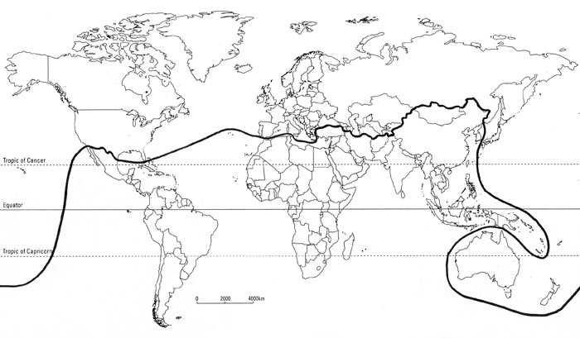
The Brandt Line
Notes:
Just GDP initially (eary 80’s)

Slide 5
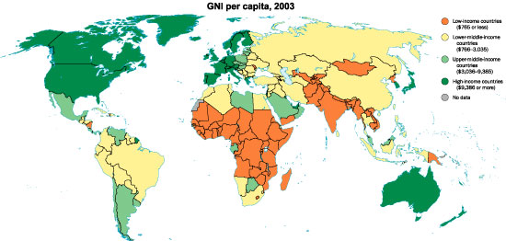

Slide 6
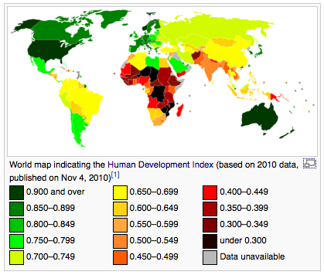
Notes:
HDI

Slide 7
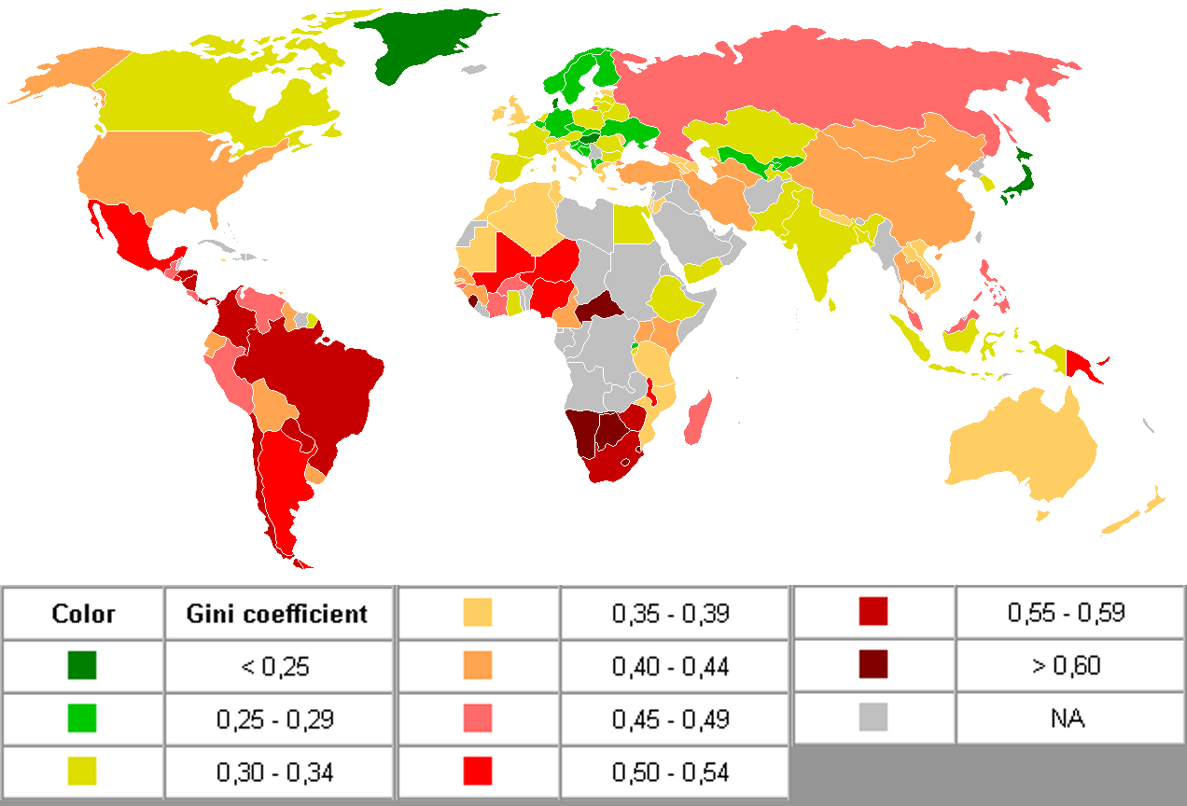
Notes:
GINI Coefficient

Slide 8
Origins
Where does money come from?
  Why are some rich, some poor?
Notes:
ORIGINS OF DEVELOPMENT (or lack thereof) SLIDE
Where does wealth/ poverty come from (individual -→ state) —destiny versus personal volition
How much do we control how rich we are? How much do states control—are some held back by factors out of their control.
Define modernization and washington consensus ( econ failures thus far the fault of policy mistakes, lazy-ness)
Defines endowment and colonial legacy as history, being the prey or the prey-or
Dependency theory: states exploited by wealthy
Even if work hard, kept out of the old money
ORIGINS: looks at the root of wealth as something influenced by history. 1) resources 2) colonialism 3) result

Slide 9
Endowment: guns, germs, steel
Climate
Geography
resources
Notes:
The first origin (DESTINY) argument: ENDOWMENT
Endowment effect SLIDE—theory: natural attributes = later development (the “starting line”—11,000 BC in uncallibrated radiocarbon dates—some peoples had a head start…?—patterns in history become amplified/repeated in the 13,000 yrs since last ice age)
CLIMATE (inhospitable → slow)—tropical = poor crop yield, bad soil, bugs, germs, slow plant growth=no crop surplus = no surplus for developmebt
GEOGRAPHY: (landlocked, mountains, water) Physical: access to ports and size of state → trade, security → development
Land locked, mountainous, water sources
Human: population → development , Size: how many mouths to feed, homes to build
Age structure: # of dependants old and young
Lots of children or elderly, depresses development
Working age increases production, development
RESOURCES (gift v curse): amount, type, diversity:
curse: Large amount of easily accessible, pointy resources or too few resources
gift: Medium-large amount of varied, beneficial resources

Slide 10
2) Colonial legacy and institutions
Notes:
Next DESTINY: colonial legacy
Based on the endowment of states, some looked outward first (had guns, steel, boats—so conquered) while others tried to survive on less arible soil. Leading to colonialism—which also influenced later development

Slide 11
Colonialism: history
1st wave:
  create stable little markets of people who would buy our goods and no others
Notes:
1st wave:
conquer territories
take some raw materials
Mostly: market creation
Based on: Merchantilism: The state needs to be powerful. The market is unpredictable. So, the state controls the market.
Active role of the state, boosting power
power and wealth are closely related-both legitimate policy goals

Slide 12
Colonialism: history
2nd wave: extractive
Take raw materials
Notes:
this era of colonialism centered less on creating/maintaining/stabilizing the market for goods
more on taking raw materials. To create goods to sell to ever enlarging markets
Take raw materials
Only enough stability/infrastructure to extract resources
Based on: Economic liberalism (laissez-faire economics)
Remove governmental involvement and the market will better generate revenue
Don’t need markets, just resources
gov’t intervention unnecessary

Slide 13
Colonial legacy: persistence
1st wave: Neo-Europe’s
2nd wave: Extractive
Lots of settlers
Result: better economic performance
Few settlers
Result: worse economic performance
Notes:
1st wave:
Settlers = strong institutions, full infrastructure (Government and constitution, Private property, Roads, Schools)
Quick development = now wealthy
2nd wave:
Few settlers just army = No infrastructure One strong leader
Weak institutions, infrastructure
Slow development= still poor
(high pop growth, political instability, stuck providing raw materials—not industrializing, etc)
Latin america doesn’t fit with this time-line but the types of colonialism favored by portugal and spain favored elites—but did build some infrastructure—so that persists as well
Less settlement than 1st wave (like 1.5 wave) (because less land so elite wouldn’t share)
Weaker development, though stronger than the official 2nd wave
Weaker institutions than first wave

Slide 14
3) Dependency cycle
States are being exploited by the wealthy and purposefully kept subjugated
When “allowed” to develop at all, still within this relationship
Notes:
Dependency theory would provide a third possible destiny argument—though we could aguably also place this as someone else’s policy that’s screwing you—but since you can’t escape, is destiny.
Modern destiny :WST/dependency theory—still going on.

Slide 15
1) First assignment
Compare examples from global North and South. How does endowment and colonial legacy come into play in their current economic and political situation?
Notes:
Consider the global south’s economic problems
(high pop growth, instability, stuck providing raw materials—not industrializing, etc)
Explain with modernization and dependency theory
1) Modernization: development is a process. Happens over time. It’s still early.
Get $ and grow wealth Industrialize
get wealthier liberalize politically
Kill 2 birds, 1 stone
2) Dependency: They’re on the butt-end of a 1st world (int’l) and elite (domestic) dominated division of labor

Slide 16
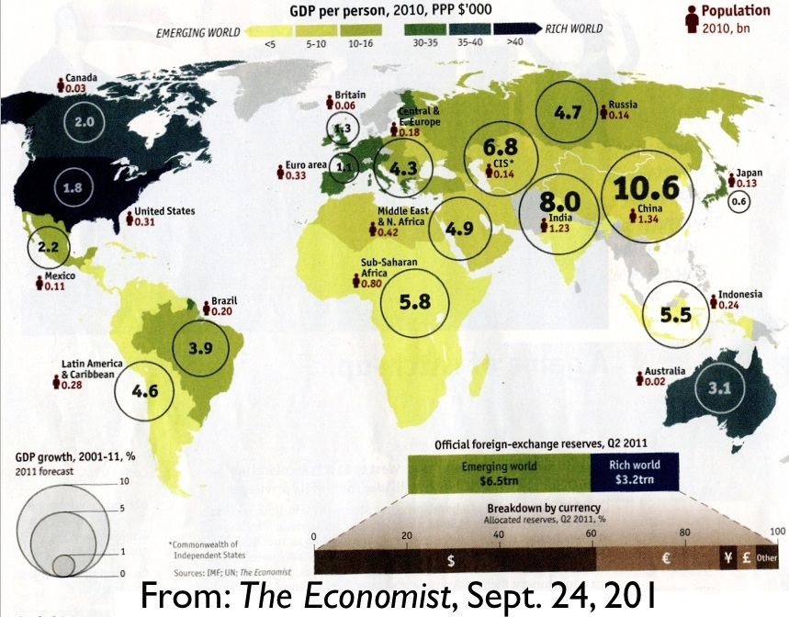
Notes:
Economist

Slide 17
Video-wealth
http://www.youtube.com/watch?v=jbkSRLYSojo

Slide 18
What Is Globalization?
a process of expanding and intensifying linkages between states, societies, economies
Notes:
Shrinking of the world: the movement towards the expansion of economic and social ties between countries
An unprecedented compression of time and space reflected in intensified interconnections…on a global scale
Is it new?
Before: Territorial boundaries more or less kept things in and out, Society and culture had spatial referents, Others?
What does it do? Good for all or bad? In what ways?
Contradictory: It integrates and disintegrates, It fosters cooperation and conflict, It engenders order and disorder, It is divisive and unifying
Types: economic (+ technology), political, cultural

Slide 19
Economic globalization
Integration of national economies into the international economy
The increasing reliance of economies on each other
Notes:
PRIMARY ONE—THE ROOT OF ALL OTHERS
Integration of national economies into the international economy
Through: trade, FDI and capital flows, international flows of workers
TRADE Examples
1) Economic integration - European economic integration (ECC → EU)
Remove physical, tech and fiscal barriers to trade, Monetary union - single currency
2) Less extreme—trade agreements
Mercoursur: South America
(primary members Argentina, Brazil, Paraguay and Uruguay/ secondary members Bolivia, Chile, Colombia, Ecuador and Peru and some non-South American trading partners like Israel and Egypt)
APEC: Asia-pacific economic cooperation—free trade agreement in asia
AFTA-asean free trade area in southeast asia
3) MNC or TNC’s – businesses with headquarters in one country but operations in a number of others

Slide 20
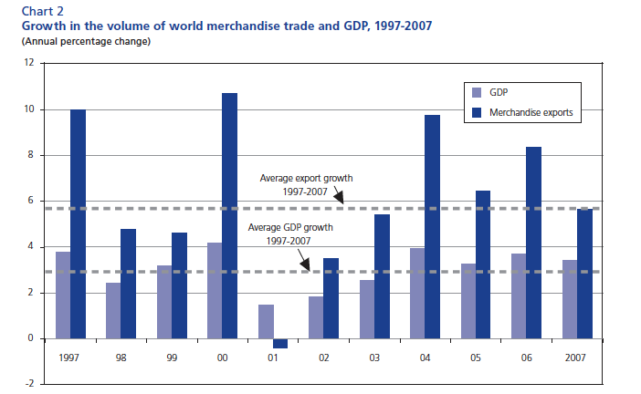
Trade growth
Notes:
State wealth becoming increasingly international-trade heavy—international trade disproportionate to before.
FDI has also grown exponentially (though most in the first world, the 3rd world’s share is growing)

Slide 21
Economic globalization: benefits
financial
diplomatic
Notes:
Benefits:
financial: Greater potential for wealth, employment; reduction of poverty
specialization
2) diplomatic: Increased ties between states
Interdependence → cooperation

Slide 22
Economic globalization: problems
Unequal access
  International, domestic
Law
Notes:
Unequal access: Capital remains concentrated among the wealthiest nations and people
International division of labor (wealthy dominate, poor stay subjugated)
Domestic: elites in poor countries gain all benefits, disadvantaged left behind and their poverty becomes more severe.
2) Weakening states and $$ in hands of corporations/merchants--weakening rule of law--

Slide 23
Technological globalization
Information, communication and mobilization tools
But: uneven access
Notes:
Information, communication and mobilization tools readily available:
Cell phones
Computers/internet
Others? (e.g. tapes in use by Khomeni making the Islamic Resolution a “cassette revolution”, satellite dishes bringing “smut” into the Gulf)
Problems:
Uneven access: Check out image on p. 292 (?)—digital divide
top down: rich 1st, mid-wealth next, poor last—so is perpetuating preexisting disparities—global and within states

Slide 24
Political globalization
The erosion of the modern nation state
increased political integration and power of non-state actors
Notes:
Political globalization basically references the fact that rule has evolved from very localized to broader entities—states even give up sovereignty to join trading blocks, etc
What is the end point? A debated effect:
States actually weakening, replaced in the future. Were originally manifestations of economy and when economy changes to global, they will too
2) States cannot die, will always be political center
BENEFITS? 1) States bound by international web of agreements that fosters greater cooperation and a decline of violence between states
2) also restrained by agreements and trade domestically—transparency, restraint in policing, etc
Golden straightjacket – FRIEDMAN--Have to liberalize economy and politics to join the club (global economy)—but if you join, get money and your public gets transparency, less domination. Changes in state autonomy and capacity
PROBLEMS: Loss of monopoly on violence means less stability and more conflict - (terrorism discussed by Hoffman-next)
Less democratic system as power moves further away from democratic institutions and public oversight (democratic deficit)
Democratic deficit—usually used in reference to the EU, where decisions are seen to be coming from above wand people no longer as influential
Lack of representation and accessibility to people in this aggregate form

Slide 25
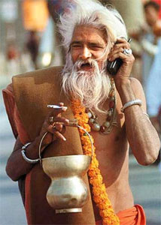
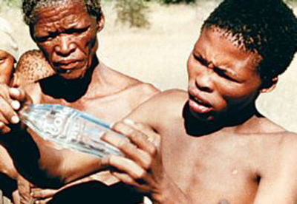
Combine these = cultural
Econ globalization
  +
Tech globalization
  +
Political globalization
  =
cultural spill over
Notes:
Econ globalization = people in contact with the goods of other states, working in other states, etc
Tech globalization = people in touch with others and their ideas
Communication, travel, etc
Both put people in touch with others
(ideas, religion, high/low culture, etc).
Then, political globalization reinforces a lack of boundaries between peoples
Increased exposure to the ideas/products/practices of other cultures leads to
Weakening of traditional societal institutions
Creation of new identities replacing old forms of individual and collective identity
Is fostered by the other globalizations (esp tech and econ) above
is culture vulnerable to change? Why?

Slide 26
Cultural globalization: benefits
Global cosmopolitanism
Global civil society, democracy
Notes:
Presumably the more contact we have with others—different views, different cultures, etc, the more tolerant we become of differences. One of the key facets of democratization, of liberalization.

Slide 27
Cultural globalization: problems
1) the “Western curse,” Westernization
2) “Death” of a culture, replacement with a “global culture”
3) cultural snapback
Notes:
All three basically argue that cultural globalization will result in a transformation/loss of of local cultures
1 the “Western curse”
Western culture becoming global
2) “Death” of a culture, replacement with a “global culture”
a new homogenized “global” culture in the making
McWorld -- all societies are changing, economic activity is becoming standardized and homogenized and organized for efficiency along the lines of fast food outlets
By the ‘McDonaldization of society’ Ritzer means that other sectors, including hospitals and universities are being organized along similar lines
3) cultural snapback: seeing either incoming culture as a threat
Reactionary nationalist movement, “return to utopian past” movements, fundamentalism, Jihad v. McWorld
Is cultural globalization a real thing? A western curse in reality/perception?
Next—two debates on these contradictory views of globalization—both asking if it causes more harm than good or good than harm. First—is is more good than bad economically? Second, can it cause more strife than peaceful interaction?

Slide 28
Next: globalization and wealth
globalization as a positive
  Dollar and Kraay’s study
1) is globalization beneficial?
2) Does it only benefit some?
  Internationally and domestically
Notes:
Remember—the contradictory effects of economic globalization are claimed to be: that while increased trade between states can make all wealthier, it tends to make some states (see global North) more wealthy and to only benefits elites within developing states.
Enrich the many or the few: Does economic globalization unfairly benefit the rich?
They (Dollar and Kraay) argue that the critiques of globalization are unfounded for a number of reasons. They break down both the benefits generally and the distribution of benefits (inequality claim)
First: yes, it’s super beneficial
For the economy in general (see next slide) and for the poor in particular (see the one after that.)

Slide 29
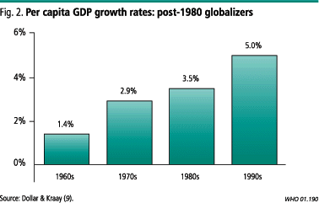
# in extreme poverty fallen
29% 1990 to 18% 2004
+ better infant mortality, education
Notes:
EVIDENCE: is beneficial to the poor
The authors use this image (in a longer version of this article) to illustrate how economic integration has boosted the economies of those that use it.
Looks impressive, right?
Conditional convergence: when starting from a point closer to absolute zero, will have speedy growth –
The “post 80’s globalizers” were not a part of the global economy until the 80’s, meaning they were either post-communist (so had been bled from USSR and finally recovering) or out of the loop economically (so are likely very poor).
But since this isn’t the only evidence, isn’t necessarily damning—there does seem to be impressive strides for poor with high growth (anything over 2% sees increases for poor too) but it doesn’t negate the argument does it?
people living on less than $1 per day. Although the percentage of the world's population living in poverty has
declined over time, the absolute number rose fairly steadily until 1980. During the Great Depression and
World War II, the number of poor increased particularly sharply, and it declined somewhat immediately
thereafter. The world economy grew strongly between 1960 and 1980, but the number of poor rose because
growth did not occur in the places where the worst-off live. But since then, the most rapid growth has
occurred in poor locations. Consequently the number of poor has declined by 200 million since 1980
Across all countries, incomes of the poor grow at around the same rate as GDP. Of course, there is a great deal of variation around that average relationship.

Slide 30
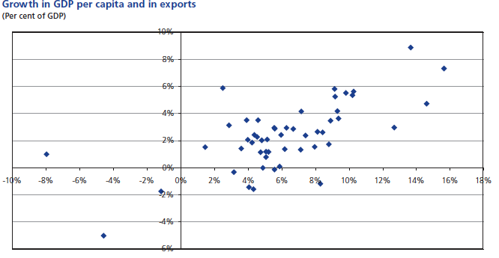
global

Slide 31
Reject inequality
trend → inequality a lot older than modern (rapid) globalization. Peaked in ’75.
  Is actually stable or maybe even declining since.
Notes:
INTERNATIONAL inequality
They reject the claim that globalization has much to do with inequality between states
Inequality was already in existence before globalization became a convenient excuse to blame.
Trend (domestic and international) pre-exists globalization
Particularly domestic inequality - related to other factors, not consistent with globalization
Depends on institutions, policy of the state
But others point out that, despite their claims, inequality has been steadily increasing on par with globalization.
Even if start point that explains who is poor, globalization It is still making inequality worse
Another explanation, maybe--next

Slide 32
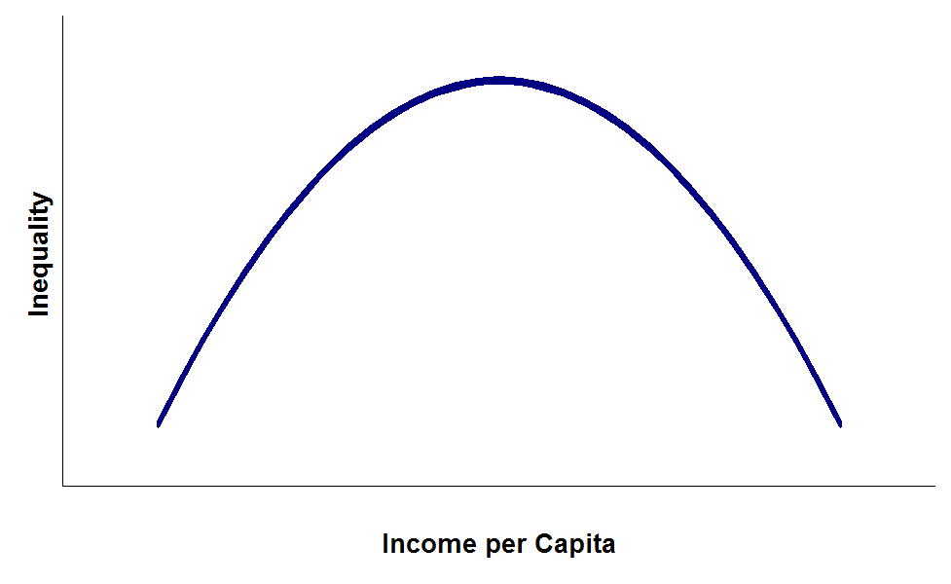
inequality?
Kuznets Curve:
Economic inequality increases over time during industrialization, rapid growth but then levels back out again
Notes:
Kuznet’s curve—inverse U-shaped curve—as countries develop, inequality increases, peaks then declines.
Upheld in parts of Europe: England (GINI: 1823 was 0.4 to 1871 .627 to 0.443 in 1901), Germany, France and even Latin America: Colombia and Brazil
But Nordic countries and some parts of Asia actually see monoticially declining inequality with development (South Korea, Japan and Taiwan)
Which is natural? Would globalization play a part pushing in either direction?
dollar/kraay think this is normal, temporary, and benefits outweigh temporary costs.
Do you buy it?
Well, they don’t consider effect on political stability—which the Huffman article does
Globalization could lead to more conflict (or maybe less conflict)

Slide 33
Francis Fukuyama: the end of history
Globalization spreads Western liberalism:
  Political and economic systems
Result: peace
Notes:
The End of History and the Last Man – arguably a liberal approach to view of globalization (we are more interconnected, spread ideas → become safer and more prosperous
Modern politics are the end of history, as such: the end point of mankind’s ideological evolution.
Globalization brings the spread/universalization of Western liberalism:
liberal democracy as the final form of of human government and
liberal economic principles as the ultimate aim
Result: beneficial. Eventually breeds democracy & stability

Slide 34
Huntington: Clash of Civilizations
globalization separates people from local identities
Creates “civilization-consciousness”
Result: Increased civilizational conflict
Notes:
Globalization will have the opposite effect (+ conflict) – arguably more of a realist view (more lines of contact = more lines of conflict)
World politics is entering a new phase in the wake of the end of the Cold War
The “fundamental source of conflict in this new world will not be primarily ideological or primarily economic. The great divisions among humankind and the dominating source of conflict will be cultural
HOW? The process of economic modernization and social change separates people from longstanding local identities
Western dominance of globalization leads to “civilization-consciousness” a return to the roots phenomenon, broadened by glob.
People become tied to their “civilization” (first micro, then macro)
Cultural differences are not easily compromised and resolved - Increased conflict with increased interaction
Who is right—globalization, westernization = peace or armageddon?
Alternative—some areas of eruption, come areas of pacification

Slide 35
Hoffman
Some reduction of interstate conflict
Increases in non-state conflict
  Reasons for terrorism
  Tools of terrorism
Notes:
Political globalization: States will continue to dominate, Won’t further reduce their sovereignty but security does become mre vulnerable with more movement between states, transparency and liberalization
Cultural globalization: Identity remains national, even if better understand others
Economic globalization + technological
Increases wealth, but also disparity (even if temporarily) uproots many
Non-state actors becoming global actors, Use of violence: terrorism
Fosters conflict and resentment:
1) Reasons for terrorism: Economic dislocation, “unjust policies”, Comparisons to the global better off (relative deprivation on a global scale), Political dislocation (states cracking down on citizens)
2) Tools of terrorism: Communication, mobility, technology

Slide 36
2) Who has it right?
Of the three: Huntington, Fukuyama, and Hoffman, who do you think is the most correct?

Slide 37
Human Rights
Political and social entitlements recognized by international law
minimal standards of human treatment
Prohibitions on state abuse
Notes:
Political and social entitlements recognized by international law – valid for individuals everywhere.
international norms that give minimal standards of how people should be treated -- help to protect all people everywhere from severe political, legal, and social abuses.
Granted to all, prohibitions given to sources of official abuse (states)

Slide 38
Human rights law
Is a form of public international law, norms
Same sources
Notes:
Sources the same as earlier lecture on International Law:
Treaties (Every UN member state is a party to one or more of the six major human rights treaties. 80% of states have ratified four or more)
, custom, general principles (shared national law)
Some argue are more fundamental because have deeper sources: natural law, religion, morality

Slide 39
Modern HR law: post WWII
UDHR: 1948
  Civil and political
  Economic and social
Notes:
Anywhere from 6 to 9 primary treaties of international human rights law
Dates to post WWII
1) Charter of UN: promote and delimits HR
2) UDHR (universal declaration of human rights): 1948
+ Covenant on Civil and Political Rights (1966)
+ Covenant on Econ and Social Rights (1966)
Collectively: international bill of human rights

Slide 40
3 major human rights debates
1) What is a right?
2) Who has human rights?
3) Who has the job to protect human rights?
Notes:
Overlapping debates and no consensus

Slide 41
Universal Declaration of Human Rights
1) Security rights
2) Due process rights
3) liberty rights
Notes:
Starting with the 1st debate—what is a right
Universal: any/all of these?
Go through UDHR covenants (big debate during cold war)
1) Security rights
Protection from murder, massacre, torture, and rape
2) Due process rights: Protection extreme from abuses of the legal system (imprisonment without trial, secret trials, and excessive punishments)
3) liberty rights: Protection of belief, expression, association, assembly, and movement

Slide 42
UDHR
4) political rights
5) equality rights
6) social rights
7) group rights
Notes:
4) political rights: protect the liberty to participate in politics through actions such as communicating, assembling, protesting, voting, and serving in public office
5) equality rights: guarantee equal citizenship, equality before the law, and nondiscrimination
6) social rights: require provision of education to all children and protections against severe poverty and starvation
#7 group rights: include protections of ethnic groups (e.g. against genocide) and the ownership by countries of their national territories and resources (including self-determination)

Slide 43
Debate # 1: Not all 7 are approved by everyone. Guesses?
Notes:
Look at social: Social
includes equality and nondiscrimination for women and minorities access to employment opportunities, fair pay, safe and healthy working conditions, the right to form trade unions and bargain collectively social security, an adequate standard of living (covering adequate food, clothing, and housing), health care, and education
Civic: right to freedom of thought and expression. freedom to seek, receive, and impart information and ideas of all kinds right to freedom of peaceful assembly and to freedom of association with others, including the right to form and to join trade unions.
But what about Security?—that includes HIR:
1) Disappearances - persons disappeared with a likely political motive and with typical knowledge of the entity/individual that perpetrated the abduction.
2) Extrajudicial killings -killings without due process of law by a government entity or private group with government sanction and include “deliberate, illegal and excessive use of force” by security/state apparatuses.
3) Political imprisonment - the incarceration for non-violent government opposition, religious beliefs/proselytizing or membership in a social, political, ethnic or racial group.
4) Torture - causing extreme physical or mental pain to individuals because of their political/religious beliefs, political behavior or their membership in any social, political, ethnic or racial group

Slide 44
Debate #2 human right?
Universalism:
  Rights are universal and fundamental
  So inherent, are possessed by all individuals regardless of origin
Cultural Relativism:
  Human values aren’t universal, they vary by culture
Notes:
Universalism: by virtue of our humanity, have rights. Even if “primitive” cultures don’t have explicit laws, will eventually
Problems: negate “traditional” laws,, Human values aren’t universal, they vary by culture, E.g. the community comes before the individual
HR is just another form of western imperialism, imposing incompatible elements. Problems - an excuse for abuse? (e.g. Syria, Iran, China) or a viable argument?
FOR Universal:
HR are minimal standards, found in most every moral code.
leave most legal and policy matters open to decision-making at the national and local levels.
Can accommodate a great deal of cultural and institutional variation.
Suggestions, not binding.
For Cultural Relativism:
Just look at the debate on which HR are HR
Listing of rights has been a political process, western dominated

Slide 45
Debate #3: who protects
Communitarianism: States protect their own
  Sovereign
Cosmopolitanism: the source of HR is humanity—universal.
  Not sovereign
Notes:
Even if there are universal human rights, where do they come from and who do we have a duty to protect, who does protecting, how?
Communitarianism (the Statist argument): States protect their own.
the source of HR is native, leaders protect those rights of their subjects.
Cosmopolitanism: the source of HR is humanity—a universal, global.
No state can deny, all states protect all humanity. HR is not a sovereign issue. all states must act to protect all humanity.
HR is not a sovereign issue.

Slide 46
3) Human Rights Assignment
Notes:
1) What do you think—regardless of who you are or where you are from—what are the basic rights that all deserve??
2) of debate #2, which do you find the most persuasive? Why
3) of debate #3, is one a more compelling argument?

Slide 47
Now: what HR abuse could mean to the bigger picture
  looking at how a state treats its weakest members
Notes:
HR can be a vague/disputed concept.
Abuse seems wrong but does it matter in the grand scheme of things?

Slide 48
Norms “transfer”?
Patterns of dominance and subordination are replicated internationally
Notes:
Do states with a lot of discrimination domestically tend to be more warlike?
Start wars, Be more aggressive in wars
Domestic discrimination = norms of violence
Dehumanize own, dehumanize others
Patterns of dominance and subordination are replicated internationally (a world view)
Elites believe superior to “others”
Politics mimics relationship: power taken by force from weaker
Both → interactions with other states
Think: schoolyard bully on other turf

Slide 49
discrimination = violent norms of behavior
Maternalist
Structural Violence
Ethno-nationalism
Notes:
In theory, yes—three accepted theories that essentially explain why:
“Maternalist” theory of violence
Misnomer: Diversity, women in political decision-making pacifies politics & teaches norms of tolerance. If “others” are allowed into politics, not as violent norms of politics
“Structural Violence”
Systematic discrimination as violence, in intent and effect if not in action. If you leave a group to die by refusing them access to food and medicine, you’ve already given up value attached to their lives. Same effect as shooting them, eventually. Excluding any group means violent engagement acceptable
Ethno-nationalism
“in-”/”out-group”, domination of others. Constructing barriers to “others” as less than you implies an underlying view of humans as more/less human, able to be violent against.

Slide 50
findings (violence begets violence)
6x more likely to initiate conflict
5x more likely to reach high levels of force in dispute
Notes:
Even controlling for the correlates (contiguity, regime, wealth, etc)….
“violent” norm states are 6x more likely to initiate conflict than non-discriminators
5x more likely to reach high levels of force in dispute—i.e. will not compromise
I can corroborate—found the following in a test of their theory. Rather than ethnic or gender discrimination, just used acceptability of violence sganst domestic politicl opponents and criminals (HIR violations) and found Those that regularly abuse HIR’s (human integrity rights—the highest of security rights)
4x more likely to make threats against other states
43% more likely to reach high levels of hostility
77-80% increase in the probability that a state will initiate a war if it is an abuser (over one with a clear HIR record)

Slide 51
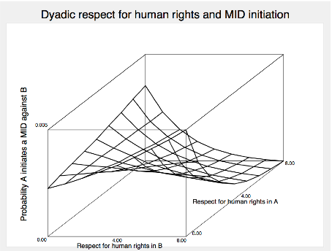
Notes:
Far right—democratic peace? Two states that respect HR. Highest corner: norm transfer, norms of violence, msot likely to initiate conflict.
This is just an example from my own work—to illustrate, nothing more.
NEXT….women

Slide 52
Historical gender disparities
Patriarchal, male-dominated social hierarchy and politics
Limits women’s
  Access to power
  Access to wealth and resources
Notes:
Women histocially not in positions of power (book lower than porportion of professionals, management, presidents, legislators, cabinet officer
lower than porportion of wealth
1) Natural? Are women inherently unequal?
Is patriarchy the natural course of social relations?
2) Even if not—does it really matter that women are kept from full participation in economy, politics of states?
3) If so, is it something that would change naturally or should it be nurtured?

Slide 53
Women: the plan
Extreme disparities and what they mean for
  1) poverty and economic development
  2) security
Notes:
Extreme exclusion
Exclusion (or extreme neglect/restrictions) of women from education, politics, economic sphere
Dramatic devaluation of female life
Big effects:
poverty, development (economic and political), stability…

Slide 54
Exclusion of women: 2 realities
1) The “feminization” of poverty
  Levels of household poverty higher among women
2) Poverty intra-household:
  Lower survival ratio
Notes:
The ‘male’ members receive more food and live longer, while the ‘female’ members receive less food to the point that their survival is drastically impaired
So, even when household isn’t impoverished, the women are

Slide 55
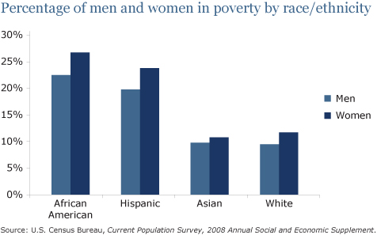
“feminization of poverty”:
US example
Notes:
And this is in the US where women have relatively equal access
Exponentially higher in places where women do not have equal access to the economy.
But does it matter in the end, do you think? YES!
Female poverty, exclusion from economy is harmful to economic development
Women generate income, invest in family education, health, and nutrition ( + HC)
Exclusion of women artificially handicaps workforce and economy

Slide 56
Women and development example
+ female primary education
  lowers birth rates, increases family health/nutrition, increases agricultural output
Increases economic output of the state
Notes:
Education: just a small increase in female primary ed = lower birth rates, better health/nutrition (family), agricultural output
In the three worst regions (sA = southern Asia, ME = Middle East, sSA = Sub-Saharan Africa) female illiteracy: development retarded
Educated women have fewer children; provide better nutrition, health, and education to their families experience significantly lower child mortality and generate more income than women with little or no schooling. Investing to educate them thus creates a virtuous cycle for their community.
Economic input: generate income, invest in family (education, health, and nutrition)
the three worst regions (sA, ME, sSA) female illiteracy: 55%, 51%, 45%
Worst economic performance as well
Exclusion of women, artificially handicaps workforce and economy, inclusion beneficial
Econ development: WHERE WOMEN EXCLUDED = high birth rates, lower output, cost draining on the state, loss of 50% of the entrepreneurs…
Getting better? Not really—relatively stagnant in these areas

Slide 57
Other benefits
political inclusion: liberalize, reject authoritarianism & extremism
Security: pacify interactions
Notes:
Liberalize: building those bridging ties, accepting differences—doesn’t work if just the men-folk
Security: The norm transfer argument holds using measures just for severe exclusion of women from economic or political sphere

Slide 58
4) discussion
Do you buy the arguments that inequalities matter?
What is holding women back, globally?
How to promote?
  Why is it not freely promoted?
Notes:
I’ve included some of my own notes and ideas below to give you a few ideas – feel free address some of the questions below in addition/in place of the ones in the slide above
Do you buy the arguments that female inequalities really matter?
Why is this rarely a subject of foreign policy?
Cultural relativist arguments
Low importance?
What is holding back: POLITICAL INSTABILITY, remnants of colonialism (lack of edu access, unstable politics)
Other cultural explanations? Other general explanations?
Is it culture? Religion? Inherent?
Traditional (rural) vs. Modern (urban) populations
The symbolic power: Prize Cow
Control women, control society
Conservative backlash, maintain control
Last vestige of secular/religious & new/old guard power struggles
How does one respect the liberties (e.g. religious rights) of others while still promoting the empowerment of women?
Is it our place to even have a say on this? Does what we think matter?
NEXT: demographics…

Slide 59
Population size and growth
Carrying capacity: maximum pop that can be supported by earth
Notes:
Does the earth have the capacity to support ever growing populations?
Carrying capacity: maximum pop that can be supported by earth
Most serious estimates, between 10 -20 billion people
But distribution matters
Are we close to reaching it? NOW: 7 billion What do you think? Will the population outstrip agricultural production?
Tech increase = higher crop yield, more living space, etc
But how much can Earth maintain?
Water and land access?
Some disregard carrying capacity. Claim additional people = sufficient creativity and innovation to break through any possible natural barriers to human population growth. Also, growth rates steadily declining. Even if rate of growth decreasing, absolute # still high

Slide 60
Some trends
Modern growth levels:
  Fertility: 2.7
more than replacement level
But fertility rates are declining
Notes:
Worldwide average
Fertility: 2.7
Still more than replacement level (what stabilizes population size). Reason: longer life span + still high average birthrate
Scary momentum: Absolute population
1 billion 1804. In 1927, passed 2 billion. in 1987, 5 billion October 1999 6 billion.
Higher and lower mortality: higher: esp pandemics, lower: technology
projection for 2050 is now around 8.9 billion (very high) But, substantially lower than the 1996 projection of 9.4 billion

Slide 61
Where is current growth?
Global South maintains high pop growth
  Already has majority of the world population
  Also has highest growth (3.1 vs. 2.7 average)
North modern population growth decrease
  some won’t maintain pop size (1.7 growth)
  Aging population
Notes:
Niger. Guinea-Bissau, Burundi all around 7
Chances are both are right—
South has high pop growth, poorest highest. Least developed 5.8 average Examples from book of 6+
Developing world will have lions share of global growth
98% of growth in the next decades
Result: Developing world will have lions share of global growth for the time being
What is the danger in this trend:
highest growth in areas that can least support large populations.
Low growth where it could be useful.
What will happen next?
A theory of population growth that might soothe then debate

Slide 62
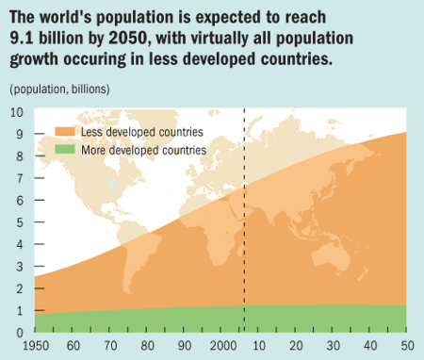

Slide 63
“stages” of growth: demographic transition theory
1) traditional societies
  Low growth
  + birth, + death
2) early modernization
  High growth
  + birth, - death
Notes:
1) traditional societies
Little growth
High birth (children = labor)
High death (die young: disease, low health care)
2) early modernization
Higher growth
Birth rates still high
Lower death (die older: improved health, sanitization and nutrition)

Slide 64
Demographic transition theory, continued
3) late modernization
  Low growth
  - birth, - death
4) Possible: post-modernization
  Declining population
Notes:
3) late modernization
Little growth
Birth rates decrease (expect children to survive)
Die older
4) Possible: post-modernization
Declining population
Birth rates decline beyond replacement levels
Aging populations
WHY FERTILITY RATES DROP: more education, lower birthrates. Jobs, decreased utility of large families,
demographic transition theory is built on the example of Europe
Population size/growth is evolutionary, Everyone will eventually go through these stages, To stage 3 or 4 (maybe)
Your opinion? Can you think of other explanations/expectations?

Slide 65
What happens next (doom)?
K & R: Localized SURGE
Longman: BUST
growth slows in North but remains relatively high in South
exceed capacity in areas
Problems: famine, war, and low development
growth will eventually decline everywhere
Aging global population
Problems: loss of entrepreneurial youth + high cost of aged = low development
Notes:
BOOM: Total population will stay too high to maintain
growth slows in North but remains relatively high in South
Growth over-concentrated, exceed capacity in areas
Problems: famine, war, and poverty
BUST: growth will soon decline everywhere, total population will drop too quickly → Total population decline
Aging global population
Problems: loss of entrepreneurial youth + high cost of aged = low development → poverty
Who has it right?
SEEMS THE SURGE IS SLIGHTLY MORE PLAUSIBLE—considering the momentum

Slide 66
5) assignment
Who has it right?
are we facing a surge or a bust?
Notes:
Most students argue that the surge seems slightly more plausible—considering the momentum—do you agree?

Slide 67
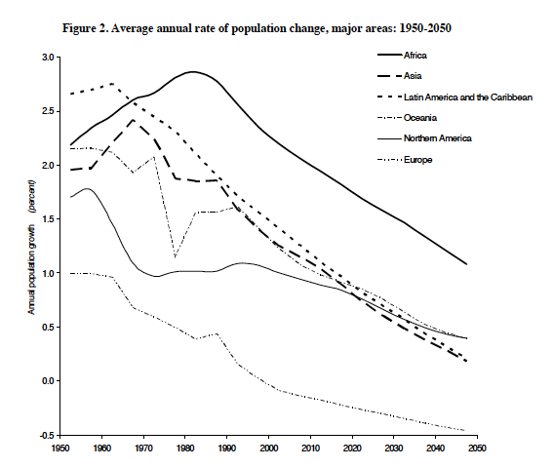
Notes:
Evidence for Bust?

Slide 68
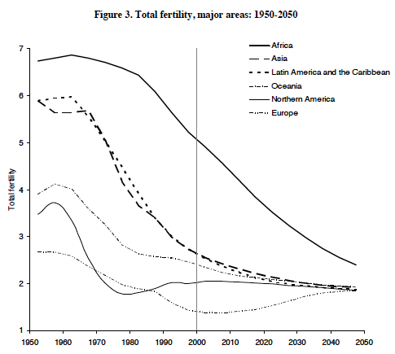
Notes:
Projection (bust)

Slide 69
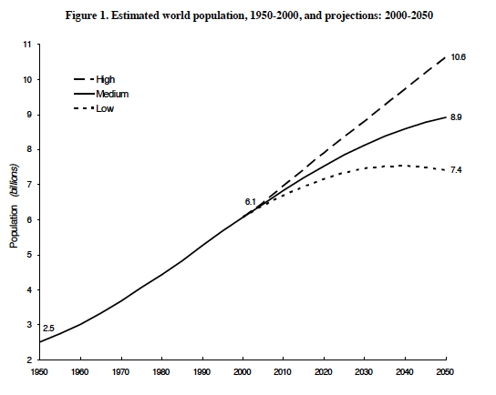
Notes:
Surge? (esp if we start living longer)
Next, and last topic: the environment

Slide 70
Some environmental problems
Ozone Depletion
Biodiversity Loss
Ocean Exhaustion
Resource exhaustion
Climate change
Notes:
Ozone depletion: 1970’s found, 1987 Montreal Protocol and since: 90% reduction
Why? Early consensus, immediate problem/solution (CFC→ ozone), small # producers, small cost to change. Others still at large:
Biodiversity loss: deforestation, desertification, loss of agriculture output
Ocean exhaustion: fewer fish, pollution, coral death, habitat destruction
Climate Change : Increased greenhouse gas levels in atmosphere. Believed to contribute to rising average global temperatures + erratic weather. Could create rising sea levels, loss of ecosystems, agricultural failure, etc .
History: 1820’s concept, 30-60’s research, 1997 Kyoto Protocol (targets to reduce emissions—189 states + ECC ratified, in force 2004) US (¼) not ratified.
Sources: Nature (e.g. climate change—natural cycles or something more? man: Industrial revolution, fuels, etc (problematic)
HOW TO BEST DEAL WITH THESE ISSUES?

Slide 71
making a case
The general argument for some type of intervention to protect the environment
Notes:
This is the plan for today, you read about problems in your readings, today, I’ll give you an analogy that expresses the theory behind a push for minimal regulation, making the assumption that some share of environmental degradation is human fault.

Slide 72
“Tragedy of the commons”
Each participant pursuing his or her own best interest brings ruins to a commons, or any open-access limited resource…
A concept used to explain both:
  Overpopulation
  Environmental destruction
Notes:
Imagine: an ocean of whales/fishing hole/common grazing land
Hardin: on population (demographic threat—carrying capacity of earth, poor decisions by individuals = loss for all) also used to explain overuse of any pool resources

Slide 73

Break it down…
Notes:
Sorry—I love DJ Lance Rock a little too much.

Slide 74
commons
commonly-held "pool" resources
No ownership, no restriction to access
Notes:
See, air: water, environment, open pasture, fishing in international waters

Slide 75
What will man do with commons?
"rational" actors
exploit common resources
costs < benefits
Notes:
Argument: individuals are short-term, self-interested "rational" actors
seeking to maximize their own gains.
Such actors will exploit common resources
(have more babies, add more cattle to pastures, pollute the air, kill all the whales)
as long as they believe the costs to them individually is less than the benefits they receive

Slide 76
Tragedy
All individuals “rational”
commons are quickly filled, degraded, and ruined
Notes:
The tragedy is:
When every individual behaves in a self-interested manner
(which they will do unless incentives to do otherwise or immediate costs to behavior)
commons are quickly filled, degraded, and ruined
Which ruins the exploiters, too
Problem: cost of maintenance is externalized
Farmers/fishermen don’t adequately pay for their impact until too late.

Slide 77
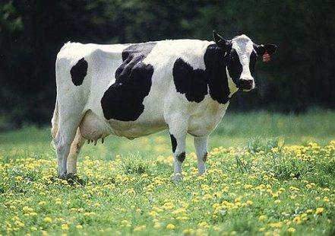
Pasture Example (the village green)
What are the benefits and costs to me of adding one more animal to my herd?
  Benefit: I get all the milk, meat, etc generated by that animal
  Costs: The village green is degraded a bit
Notes:
In the village green—the pasture that all share ownership of and graze cattle
presumably there is a threshold for number of cattle overall.
But if we benefit individually from pushing our share up a bit, will do so—overwhelm the commons
If everyone behaves like me, the village green is destroyed and all of our cattle die. OR market for meat deteriorates.
Suboptimal outcome

Slide 78

Crabbing example
Notes:
If crab fishermen harvest only a small percentage of the total crab population there will be enough crabs remaining to fully replenish the population for next year’s harvest.
But if each individual fishermen uses the best technology to take as many as possible..... (and get a little more money to pimp their ride,
there will be too few crabs remaining to fully replenish the population for next year’s harvest.
The actions of self-interested individuals en masse → the harm of all

Slide 79
“Tragedy” recommendation:
Men aren’t angels
regulate
Notes:
Men aren’t angels, so without some type of regulation, will abuse the commons:
the environmental “commons” (air, water, etc)
+ overpopulate
Need to protect resources.
So, should induce/entice protection
Could this relate to global warming, general emissions levels as well?
What other common goods can this relate to?

Slide 80
Ecopolitics: policy to manage human impact on the environment
  environmental protection policy and sustainability initiatives
Notes:
How do you induce/entice change?
Should eco politics be local, national or international and why?
What forces undermine ecopolitical efforts
Sovereignty (same old) No overarching authority -- Can’t force compliance
Environment vs. development
Environmental legislation vs. WTO decisions on “barriers to free trade”
Developing world: industrialization
Developed world: growth, price of change

Slide 81
Questions to consider
Is there a contradiction between efficiency and democracy?
  Between capitalism and sustainable development?
How important is environmental policy?
What pushes states to pursue environmental regulation?
Notes:
How important is environmental policy?
1) Env destruction → economic/security problems
2) Env destruction hyped. Uncertain effects
Example: look at the transformation of the energy system from hydrocarbons to solar, wind, biomass, etc
Vulnerability = change?

Slide 82

6) last assignment
Choose an angle
You are in charge of a PR campaign to convince the public that there is/is not something happening to our climate
What are the key arguments you will use, policies you suggest?
Notes:
be creative

